Slide 1
Coaching in CBME/CBD: Let’s Make it Practical and Meaningful!
Faculty Development Day, November 11, 2019
Janet Bodley, MD, MEd, FRCSC

Slide 2
Learning Objectives
Describe how coaching will help to facilitate CBME/CBD
Apply coaching principles to obstetrics and gynecology postgraduate training
Practice feedback conversations that support excellence in coaching
Establish the principles associated with building a growth mindset

Slide 3
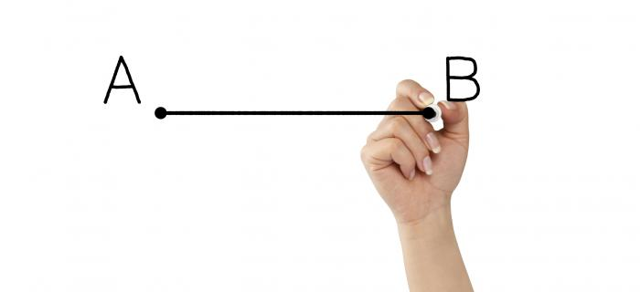
Coach
A coach is a person guiding another through a process, leading to performance enhancement
A coach helps an individual to do some task better, develop a new skill or achieve a specific goal
RCPSC “Meantime Guide”

Slide 4
Coaching AND Medical Education
The Coach facilitates the self-directed learning of the trainee through:
Questioning
Active listening
Appropriate challenge in a supportive and encouraging climate
The Trainee strives to increase self-awareness and personal responsibility for learning

Slide 5
Coaching in Medical Education
Consistent, Longitudinal
Built on a relationship of trust
COACHES:
Understand the system and curriculum
Do not need to be experts
Facilitate reflection and prioritize goals
Active Listening
Notes:
We don’t always have the opportunity for longitudinal relationships especially with trainees who join is for an elective or a short block, yet we can still use these opportunities and provide coaching in the moment. If we accept the relevance of coaching techniques to facilitate learning and CBD, then ‘in the moment’ opportunities are better embraced. We can still aim to: Introduce the team, Discuss expectations, outline/review Learning goals, Debrief the day, co-create Take home messages, create Next steps for learning

Slide 6
Coaching in Medicine is not the Same!
The Music Coach
The OB/GYN Coach
Trained to be a coach
Usually not an ‘expert’ performer
Task is to coach the student
No ‘third party’
Usually paid to coach
Usually cannot ‘take over’
‘harsh’ environment, highly critical
Informal coach (ie not trained)
Often an ‘expert’/highly skilled (but not always)
Multiple tasks
Third party: patients
Usually not paid to coach
Usually can ‘take over’
Nurturing environment, balancing support & challenge
Notes:
Even parent volunteer coaches are usually required to take some courses in coaching and depending on the level/competitiveness of the team, more training is required.

Slide 7
How will coaching help to facilitate CBD?
Improved focus on competency attainment benefits from coaching
helping learners self-identify the best path to success
Hold learners accountable for identifying and closing gaps in their knowledge, attitudes and skills
Contribute to life long learning – continual cycles of reflection and improvement to remain competent

Slide 8
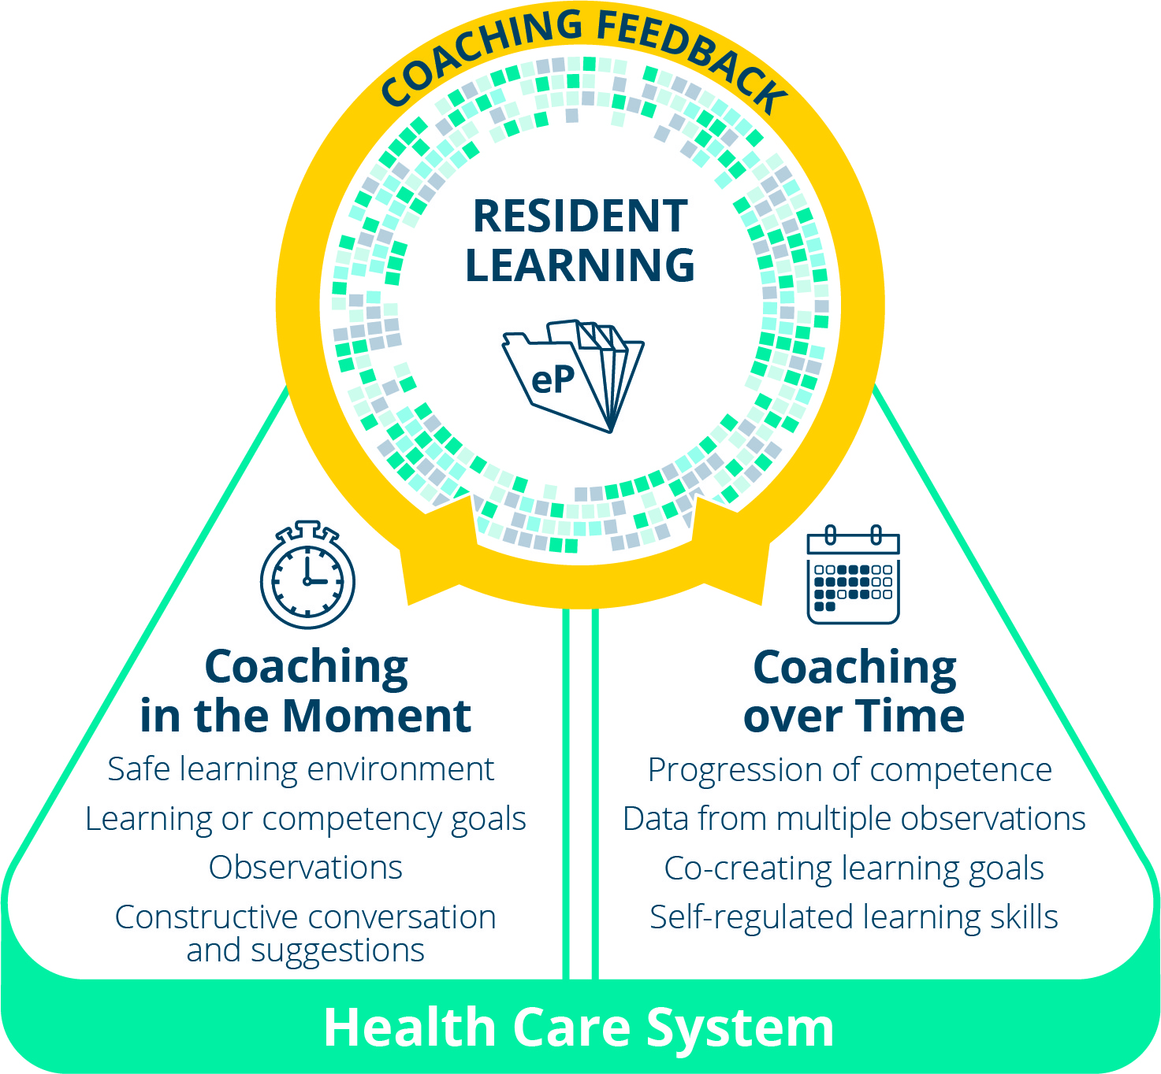
CBD Coaching Model
Facilitating learning and development of a residents’ competence

Slide 9
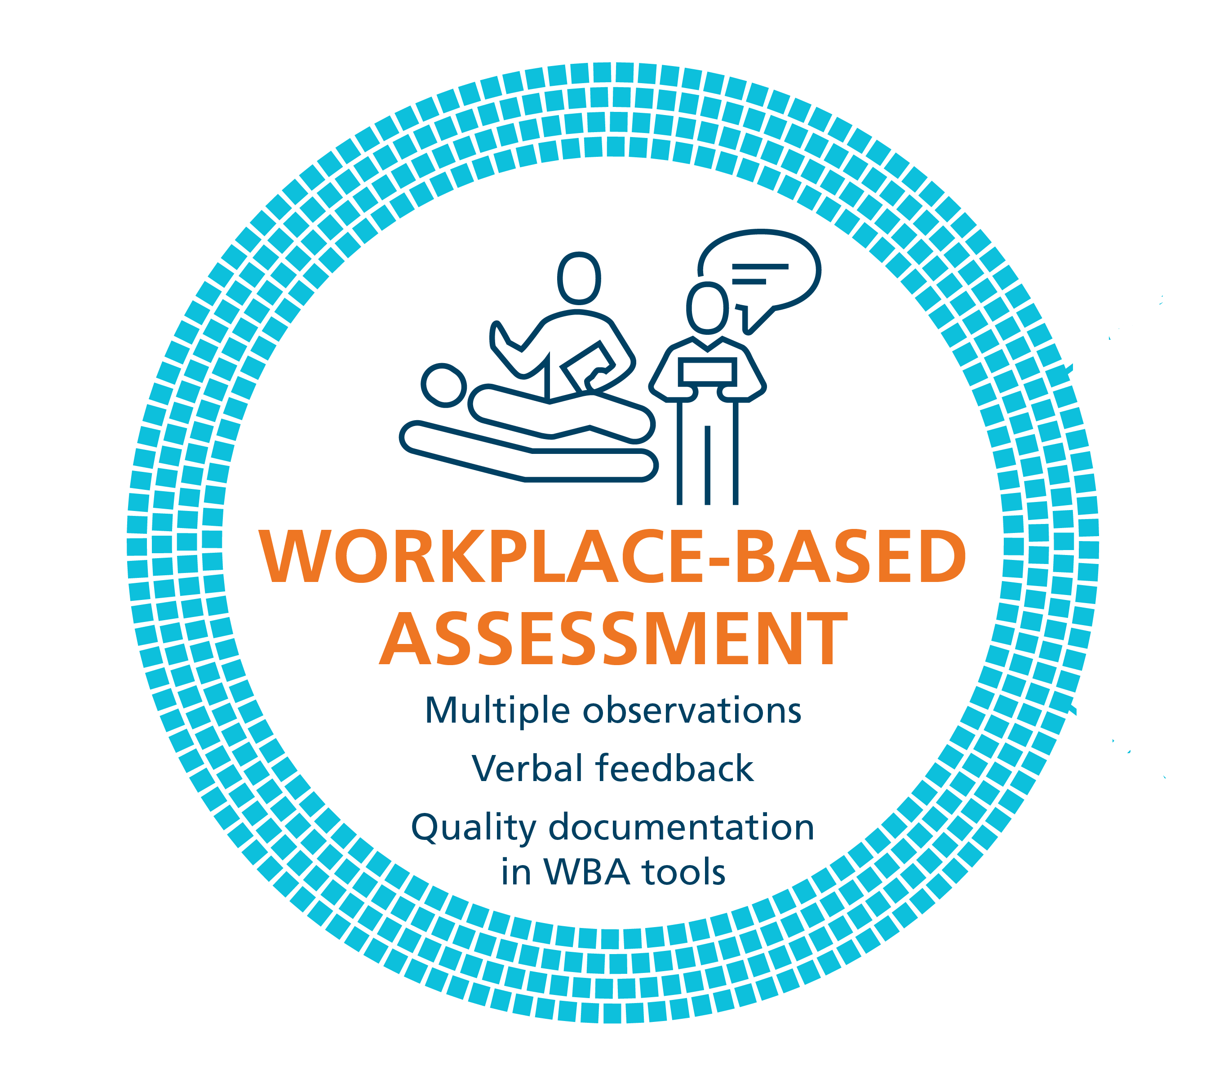
Coaching in the Moment: A Process
RAPPORT
EXPECTATIONS
OBSERVE
COACH
RECORD
RX-OCR
Notes:
Coaching in the Moment follows a process, and when done well there is tremendous value in the information given and its utility for the resident’s learning.
This process has been coined as the RX-OCR coaching process. It occurs between the clinician teacher, who we now refer to as “clinician coach”, and the resident.
The steps in the process are:
1) R: Establishing educational “Rapport” between the resident and the clinician; an educational alliance or partnership;
2) X: Setting “eXpectations” for the particular clinical time period;
These initial 2 steps need not take longer than a few minutes.
3) O: “Observing” some type of work that the resident does;
4) C: Engaging in a “Coaching” conversation for the purpose of improvement of that work;
5) R: “Record” a summary of the dialogue that occurred so that the resident can build a portfolio of observations demonstrating progress and areas to be improved.
The next slides will elaborate on each step.

Slide 10
Initial Conversation: Rapport
Employ techniques to create a safe learning environment
Form an educational partnership – Growth mindset
Being explicit about the part of the clinician’s role as a learning coach
RAPPORT
Notes:
The initial conversation, RAPPORT development, as implied, needs to occur at the outset of any learning experience as it will serve as foundational to convey to the resident an established safe learning environment.
Establishing this learning partnership (or educational alliance) between the resident and clinician is a critical reason for the initial conversation. It confirms, for the resident, the clinician’s engagement in the educational process, and specifically the clinician’s commitment to providing guidance for the growth and development of the resident; in other words, employing and conveying a growth mindset. Explicitly stating this is important to assure it is understood.
This initial discussion could also allow the resident to disclose past experiences and preferences related to learning and assessment. Similarly, the clinician could convey their style in the learning environment.
RAPPORT is the “R” in RX-OCD
Image source: https://pixabay.com/en/shops-partnership-cooperation-1014038/

Slide 11
Initial Conversation: Expectations
Discuss specific learning goals and objectives, related to milestones, competencies and EPAs
EXPECTATIONS
Notes:
Discussing specific learning goals and objectives, particularly as related to milestones, competencies and EPAs (Entrustable Professional Activities) that the resident is currently working toward, while considering the particular expectations of the clinical setting, will assure that both the resident and clinician have a shared understanding and agreement from the outset.
Again, this discussion need not take longer than a few minutes at the beginning of a clinic or a day or week working together.
EXPECTATIONS is the “X” in RX-OCD

Slide 12
The Wisconsin Surgical Coaching Framework, Greenberg et al. Ann of Surg 2015

Slide 13
Observation of Work*
Workplace- Based Observation
* Key ingredient in Assessment FOR Learning
OBSERVE
Notes:
Observation is the cornerstone to workplace-based assessment and being able to provide coaching feedback. The workplace is ideally suited for learning by doing.
Clinical experiences may be short in duration (e.g. a resident spending one half day clinic with a particular staff clinician). However, such short duration clinical experiences DO NOT negate the possibility for “Coaching in the Moment”. It is essential that observations are made and suggestions for improvement given.
Related to clinic set up and flow, some of the direct observation of a resident may be more related to a clinical work task(s) needing to be done. In other words, what may be observed would be related more to the patient’s presenting condition rather than to the specific learning goals that were initially discussed. However, the resident’s goals and objectives (possibly the EPA being worked on) do need to be taken into account, and might require specific planned observations.
OBSERVE is the ‘O’ in RX-OCD

Slide 14
Observation
Direct Observation
a clinician watching a resident doing work
in real time or asynchronously (i.e. videotaped)
Indirect Observation
review of products of the resident’s work
clinical notes, presentations, or written reflections
observations from secondary sources
Notes:
FACILITATOR TIP: Your colleagues may have doubts about the practicality of “directly observing” everything all of the time for CBD. This slide is meant to reassure them that they don’t have to: indirect observation is ok too.
Direct observation of performance (i.e. when a clinician is watching the work being done – in real time or asynchronously, for example via video recording) is of paramount importance and needs to make up a substantive proportion of the observation of work that takes place.
However, this is not to say it is the only form of observation of work.
On some occasions, observation may occur indirectly. An example of an indirect observation of work includes review of products of the learner’s work. For example, a review of clinical notes, presentations, or written reflections would be indirect observations of a learner’s work. Additionally, another form of an indirect observation would be observations from secondary sources, such as in a multi-source feedback process. In this case, the observation of performance or work is done by someone else: another clinician, staff, patient or family but communicated back to the clinician working directly with the resident.

Slide 15
Engage in a Conversation
Between the clinician and the resident
Related to the task that was observed
To ensure the resident understands how improvements could be made (growth mindset)
CONVERSATION
Notes:
Critical to the process is the dialogue that must occur between the clinician and the resident once the clinician has observed the resident or the resident’s work.
The purpose of this conversation is to ensure the resident understands how improvements could be made. This is “coaching feedback”.
This type of coaching conversation would happen, most often, after the particular work task was completed but still “in the moment” of that clinical experience.
In some instances, this feedback may be offered as the work is being done with the clinician providing real time coaching in the moment. This, of course, needs to be agreed upon by the resident and the clinician prior to the observation occurring and is dependent on the context.
CONVERSATION is the ‘C’ in RX-OCD

Slide 16
Record a Summary
Recording a summary of feedback and actionable suggestions for improvement that were given is essential
Every Coaching interaction might not be documented but a representative sample during that clinical time is needed
It is important to document outlier performances because they could be rare but important
RECORD
Notes:
A final but essential step to the CinM process is for the clinician to take a few minutes to document a summary of the coaching feedback dialogue that takes place (at least some of the time) in the resident portfolio.
Every coaching interaction might not be documented in clinical experiences of longer duration, but a representative sample of the observations during that clinical time period is essential. For short duration clinical experiences (i.e. a resident spending only one half day clinic with a particular staff clinician) the goal should be for at least one coaching conversation to be recorded. In some instances, more than one observation of work and coaching opportunity might occur in one clinic and could be documented.
It is not critical that the clinician know whether what was observed is a representative performance of a task for a particular learner. Documenting observations and suggestions for improvement, whether representative or an outlier execution of a task, helps create a comprehensive illustration of competence. Any one observation leading to Coaching in the Moment is not high stakes and will not lead to grave consequences, but is part of the process to support resident development and progress.
Whether or not a clinician documents an encounter does not restrict the resident from making their own record of the feedback and suggestions given, including their personal reflections on how it was helpful for and/or integrated into their practice performance.
RECORD is the second ‘R’ in RX-OCR

Slide 17
Feedback conversations that support excellence in coaching….

Slide 18
3 Types of Feedback
1. Reassurance
Acknowledging the work being done, and expressing appreciation by letting the receiver know they are on the “right track.”
2. Benchmarking
Letting the receiver know how they’re doing in relation to the giver’s expectations, i.e. “where they stand.”
3. Performance Improvement
Giving actionable advice with the goal of getting the receiver to the “next step.”

Slide 19
Coaching Feedback
Coaching Feedback
Feedback
Observation of Work
Coaching Feedback = feedback + actionable suggestions for improvement
Feedback = information about what was observed compared to an expected standard
Observer makes determination of quality of observed task
Notes:
In the CBD Coaching Model we encourage clinicians to think of themselves as coaches, guiding learners through a process that leads to performance enhancement. Coaches can help an individual to do a task better, develop a skill they don't yet possess or achieve a specific goal:
Like a good coach – clinical teachers must observe the resident practice a skill and then talk with the resident about what they saw. When clinicians do this, they’re giving residents feedback on what went well and what didn’t, compared to an expected standard.
The best coaches, though, continue the conversation with their athletes – they also discuss expectations for improvement and they identify specific things that the athlete can do to meet those expectations. Coaching helps a resident understand what adjustments and modifications will allow them to progress to the next level of capability/proficiency.
Feedback is defined as ‘'Specific information about the comparison between an observed performance and an expected standard, given with the intent to improve the trainee's performance.”
Coaching feedback is more than simply providing information, coaching feedback defines specific, actionable improvements that the resident can make and suggestions for how such improvements can be accomplished.
The CBD Coaching Model wants clinician teachers (observers) to aim towards the outer ring of this diagram (i.e. where the observer becomes a coach who offers the learner explicit, actionable suggestions for improvement).

Slide 20
How to Give/Receive Feedback
Confirm Feedback Readiness
Determine the type of Feedback required.
Feedback needs time and space
Label feedback as feedback
Stick to the Facts.
Engage in Reflection
Conversation for Improvement
Plan Actionable Next Steps & Review at Next Encounter!

Slide 21
Create a Coaching Culture in ob/gyn training
From Assessment OF Learning
(summative assessment, high stakes,
judging in the moment, FIXED mindset)
Assessment FOR Learning
(formative assessment, low stakes, identify
learning needs, GROWTH mindset)

Slide 22
What is a growth vs fixed mindset…?
Learning laparoscopic surgery
Fixed – I’m not good at this now so I never will be
Growth – I’m not good at this now so I need to keep working to improve
Same principle when teaching a skill
We are quick to label someone as having “good hands” or not (fixed)
Rather than a focus on coaching for improvement (growth)
Accuracy of self-perception
Fixed – Terrible at estimating their own proficiencies
Growth – Very accurate in gauging their current abilities
Notes:
Consider discussion that both faculty and trainees benefit from having growth mindsets; as faculty if you ‘write the trainee off’ because you have a fixed mindset that they will never learn and/or improve then you cannot give them the coaching/guidance/feedback they need to improve.
Part of this is innate – studies of children doing puzzles that got harder – fixed mindset got frustrated and didn’t want to do hard puzzles and felt they just weren’t good at it – growth mindset wanted to keep working at it and doing even harder puzzles to get better
Coaching is helpful
Feedback is essential
Coaching is good; Feedback is good
Feedback is bidirectional
The purpose of coaching and feedback is to provide information/assessment that will promote further learning

Slide 23
Growth Mindset
Growth Mindset: Aligns with coaching as a teaching and learning method to promote development.
Fixed Mindset | Growth Mindset
Believes that level of achievement is predetermined, and that effort dedicated toward learning will not promote greater achievement. | Believes there is potential for an individual’s growth and improvement .
Desires to prove and avoid looking unintelligent. | Desires to learn, and looks for opportunities to challenge current status.
Asks: Will I succeed or fail? Look smart or not? | Asks: Will I grow? Will I overcome challenges?
Questions the effort of bothering. | Believes that growth and learning require effort.
Ignores constructive criticism. | Learns from feedback and uses it to improve.
Dweck, 2006
Notes:
Carol Dweck is Psychology professor, at Stanford University, in California, and she has been doing research on achievement and success of students for the last several decades. She coined the terms “Growth Mindset” and “Fixed Mindset” to describe peoples beliefs about and therefore their approach to learning.
The Growth Mindset, is one in which it is believed that there is potential for an individual’s growth and improvement and this very much aligns with coaching as a teaching and learning method to promote development.
Whereas someone who ascribes to the Fixed mindset (example features of which are in the yellow column) believes the level of achievement is predetermined, and effort dedicated toward learning will not promote greater achievement.
According to Dweck, someone with a Growth mindset has:
a high DESIRE to learn, looks for opportunities to challenge their current status & grow as a result of taking on challenges,
learns from feedback and wants to know how to improve, while recognising that the improvement will require practice and effort.
In contrast, someone with a Fixed Mindset perspective:
approaches situations with a judgement lens, wondering “how will I look – smart or not?” Individuals who are of a Fixed Mindset don’t value challenging situations as learning opportunities
because effort is pointless as is responding to feedback
If we consider this in the context of clinical teaching, from the residents’ perspective – someone who is aligned with a Fixed Mindset would view observation done by a coach as an assessment at that point in time for what they know, and that judgements and decisions about my future will be made based on this point in time status. This could be called an “assessment OF the learning” that has taken place.
Someone holding a Growth mindset, would see an opportunity to have an expert coach observe their work at any point in time as an opportunity to get expert input and feedback on what they could improve. This could be called an “assessment FOR learning”
Dweck, C. S. (2006). Mindset: The new psychology of success. New York: Random House.

