Slide 1
SOON Consensus Working Group on Fetal Growth
How to choose the right chart?
May-1st, 2019

Slide 2
Universal vs. Customized Charts
Universal charts
Race specific charts
Customized charts
E.g., Intergrowth-21
E.g., NICHD, WHO
E.g., GROW (Gardosi)
All fetuses have the same genetic growth potential
Should adjust for race/country
Adjust for all PHYSIOLOIC factors affecting fetal growth:
Race
Maternal height
Maternal weight
Parity
Fetal sex

Slide 3
10th percentile of various references
10th%
Intergrowth-21 (EFW)
NICHD (EFW, white)
WHO (EFW)
Kiserud et al., PlosOne Jan-2017

Slide 4
To POOL or not to POOL That is the question

Slide 5
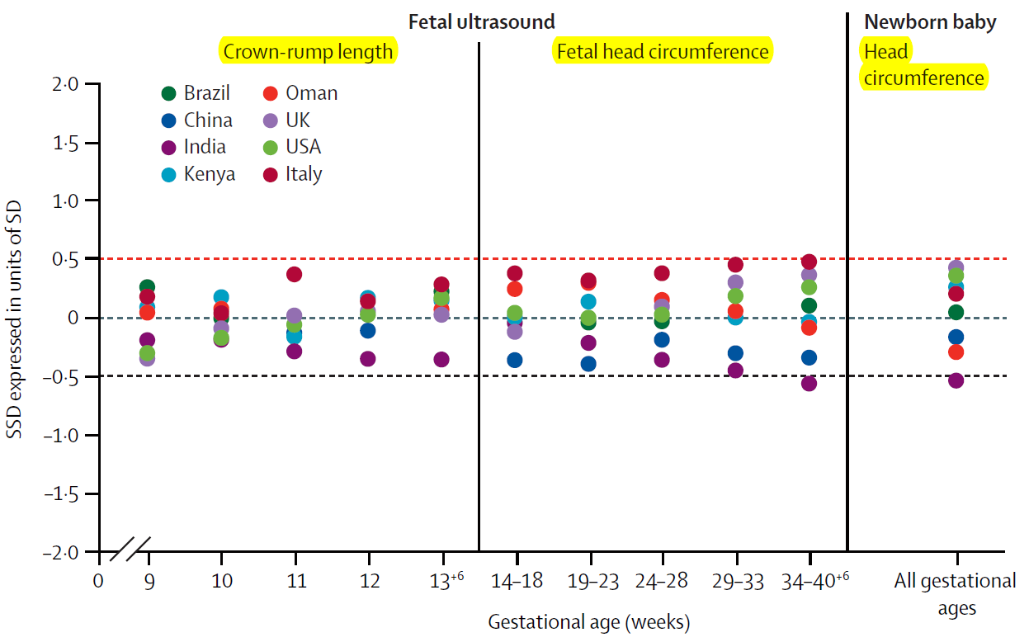
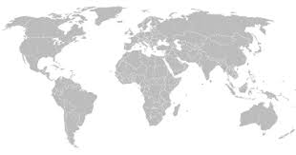
IG-21st: criteria to pool data
“...differences are not large enough to not allowing pooling them together”
?Differences in AC & EFW

Slide 6
IG-21
WHO

Slide 7
Should we use Universal Charts?
China
BJOG 2016
AJOG 2016
New-Zealand
UOG 2016
UOG 2017
UK
France

Slide 8
Should we use Universal Charts?
Proponents
Simple
Comparison between different populations (indicator of public health)
WHO Universal charts are used to monitor childhood growth
Opponents
An ‘average’ chart may lead to over- & under-diagnosis of IUGR
Depends on an arbitrary decision of which sites are included
Even if skeletal indices (HC) are similar, it is fetal weight and AC (not HC) that are associated with FGR and stillbirth, and they are likely to be quite different between countries
Intrauterine growth ≠ childhood growth
Shorter time frame (13-14 weeks)
More severe consequences of delayed diagnosis of FGR

Slide 9
How to choose the best chart?

Slide 10
1. Statistical approach
Find the chart that best matches the distribution of fetal weight in low risk pregnancies in your own population
 | Expected | Hadlock | IG-21 | WHO | NICHD | Kramer
Proportion of EFW<3rd% | ~3%
Proportion of EFW<10th% | ~10%
Proportion of EFW>90th% | ~10%
Proportion of EFW>97th% | ~3%

Slide 11
Rate of SGA<10% in Ontario (37-40w, low-risk, n=181,882)
NICHD
IG-21
Hadlock
WHO

Slide 12
Rate of SGA<10% in Ontario (37-40w, low-risk, n=181,882)
~70,000 births /year in SOON
Asians ~27% = ~19,000/year
NICHD
 | NICHD | Hadlock | WHO
Rate of SGA in Asians | 9.9% | 16.5% | 20.7%
#of cases of SGA in Asians | 1881 | 3135 | 3933
Hadlock
WHO

Slide 13
Rate of SGA <10th% - Sunnybrook data

Slide 14
Birthweight vs. U/S Based Chart
10th%
Hadlock (EFW)
Kramer (BW)

Slide 15
2. Outcome-based approach
5th%
Adverse outcome
Stillbirth
Neonatal death
Neonatal morbidity
Asphyxia
No clear cut-off ➔ trade-off between detection rate and false-positive rate

Slide 16
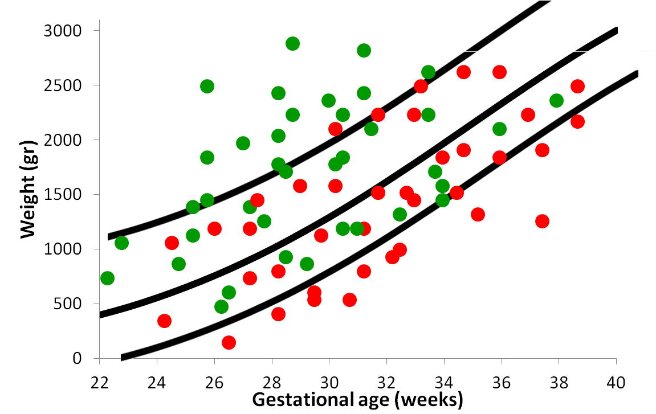
Predictive accuracy of SGA<10% for unexplained in Sunnybrook (n=108)
 | Hadlock | IG-21 | WHO | Kramer
Sensitivity (DR) | 61.1% | 53.7% | 63.0% | 49.1%
Specificity | 88.1% | 94.1% | 85.7% | 89.6%
PPV | 1.1% | 2.0% | 1.0% | 1.0%
NPV | 99.9% | 99.9% | 99.9% | 99.9%
LR+ | 5.15 | 9.16 | 4.39 | 4.72
LR- | 0.44 | 0.49 | 0.43 | 0.57
WHO
IG21

Slide 17
Summary
Choice of right chart has important implications
General agreement that US-based chart should be preferred over BW-based charts
Statistical validation (rate of SGA<10% ~=10%)
NICHD – seems to be most suitable to Ontario
IG21 – under-detects SGA (~5%)
Hadlock, WHO – over-diagnose SGA in Asian, Black
Kramer – under-detects SGA <37 weeks
Outcome-based validation
No information re ethnicity → cannot assess NICHD
IG-21, Kramer – SGA has lowest DR but highest specificity for stillbirth

Slide 18
DISCUSSION
 | Pros | Cons
Hadlock | Simple - used by most centers | Old Over-diagnose SGA in non-white population
IG-21 | Simple, excellent methodology, universal chart | May under-detects IUGR
NICHD | Optimal detection of SGA, North American | Requires using race-specific chart
WHO | Simple, excellent methodology, universal chart | Over-diagnose SGA in non-white population
Kramer | Consistent with neonatal assessment, Canadian | Under-detects IUGR <37 weeks
Customized | May improve detection rate & FPR | Cumbersome, time consuming

Slide 19
1. Which TYPES of charts are available?

Slide 20
AJOG 2016
Compare the performance of IG-21st and a customized standard in their local population
Prospective data of 53,484 live birth >33 weeks (New Zealand)
Statistical correlation
4.5%
11.6%

Slide 21
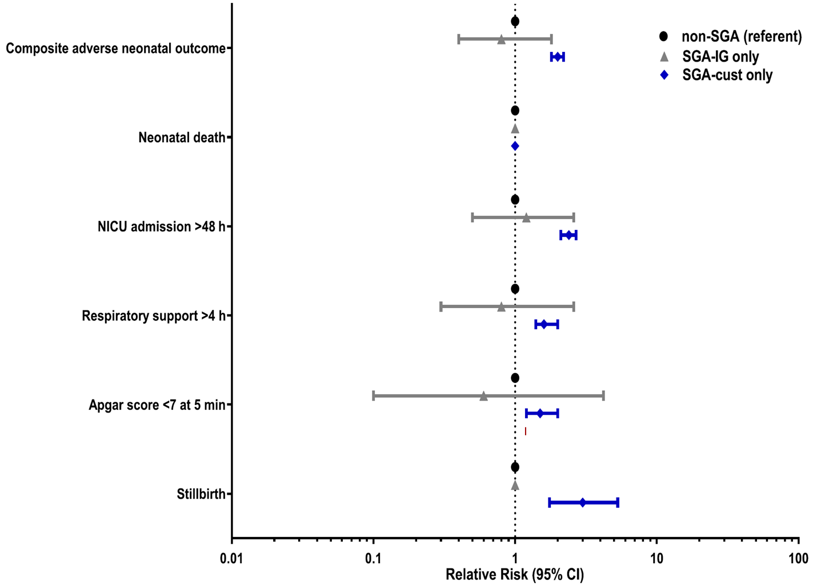
Correlation with outcome
Composite outcome:
Neonatal death
NICU >48h
Ventilation >4h
5-minutes Apgar <7
The INTERGROWTH-21st standard is not suitable for their population

Slide 22
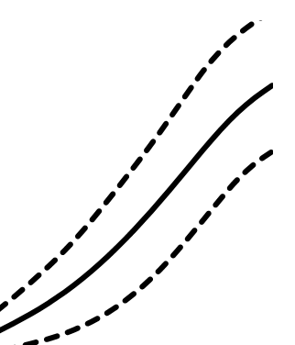
Reference vs. Standard Charts
E.g., Kramer
E.g., Hadlock
Reference
Descriptive (actual growth)
ALL pregnancies
Standard
Prescriptive (optimal growth)
Only low risk pregnancies
vs.
10%
10%
5%
3%

Slide 23
Birthweight vs. Ultrasound-based Charts
E.g., Kramer
E.g., Hadlock
Birthweight-based
(newborn weight)
Ultrasound-based (estimated fetal weight)
vs.
Ultrasound
Birthweight

Slide 24
10th percentile of various references
Hadlock 1991
Ultrasound-based
standard
Population
N=392
Low-risk
Mainly white women
Huston, TX
Dating: US or clinical
Hadlock (EFW)
10th%
Hadlock et al., Radiology 1991

Slide 25
10th percentile of various references
Kramer 2001
Population-based reference
Based on birth weight data in Canada (excluding ON) 1994-1996
N=676,605
Hadlock (EFW)
10th%
Kramer (BW)
Kramer et al., Pediatrics 2001

Slide 26
Birthweight vs. Ultrasound-based Charts
AJOG 2001
“Fetal growth standards are more appropriate in predicting the impact of birth weight category on the risk of spontaneous preterm delivery than are neonatal growth standards.”
Arch Dis Child Fetal Neonatal 2007
“Using fetal growth rather than birth weight standards gives a better indication of the incidence and role of FGR in neonatal disease.”
True North Imaging (Kramer): 2nd trimester - look mainly at the AC and not EFW

Slide 27
2. What are the best charts available?

Slide 28
10th percentile of various references
Hadlock 1991
U/S standard most widely used
Population
N=392
Low-risk
Mainly white women
Huston, TX
Dating: US or clinical
Hadlock (EFW)
10th%
Hadlock et al., Radiology 1991

Slide 29
10th percentile of various references
Intergrowth-21st 2014-2016
Goal: universal chart
Prospective int’l longitudinal study
N=4,321 women
8 low- and high- income countries
VERY Low risk pregnancies
Single international
chart (‘one size fits all’)
Hadlock (EFW)
10th%
Intergrowth-21 (EFW)
Lancet, 2014
Stirnemannet et al., UOG Dec 2016

Slide 30
10th percentile of various references
NICHD 2015
Prospective multi-
center longitudinal study in the U.S.
(2009-2013)
N=2,334
Low risk pregnancies
Race-specific standard curves
Hadlock (EFW)
10th%
Intergrowth-21 (EFW)
NICHD (EFW, white)
Germaine et al., AJOG 2015

Slide 31
10th percentile of various references
WHO 2017
U/S based standard
Goal: Universal chart
Prospective multi-
center, international
longitudinal study (10 centers)
Population
N=1,387
Low risk pregnancies
Hadlock (EFW)
10th%
Intergrowth-21 (EFW)
NICHD (EFW, white)
WHO (EFW)
Kiserud et al., PlosOne Jan-2017

Slide 32
10th percentile of various references
Hadlock 1991 vs. WHO 2017
Hadlock (EFW)
10th%
WHO (EFW)

Slide 33
10th percentile of various references
WHO 2017
Ultrasound-based
standard
Prospective multi-
center, international
longitudinal study (10 centers)
Population
N=1,387
Low risk pregnancies
Considerable differences between countries ➔
Curves may need to
be adjusted to local
population → supports NICHD
10th%
Intergrowth-21 (EFW)
NICHD (EFW, white)
WHO (EFW)
Kiserud et al., PlosOne Jan-2017

Slide 34
DISCUSSION

Slide 35
Rate of LGA>90% in Ontario (37-40w, low-risk, n=181,882)

